Slide 1
Project Status Report
Presenter Name Himanshu Gupta
Ishaan Dewangan
Mihir Kumar
Anshul Dubey
Salil Jain
Presentation Date 21st June,2017
Study of the Electrical system of the new Power and Blowing Station II.
Emergency calculations for power requirements in case of power failure.
Notes:
This template can be used as a starter file to give updates for project milestones.
Sections
Right-click on a slide to add sections. Sections can help to organize your slides or facilitate collaboration between multiple authors.
Notes
Use the Notes section for delivery notes or to provide additional details for the audience. View these notes in Presentation View during your presentation.
Keep in mind the font size (important for accessibility, visibility, videotaping, and online production)
Coordinated colors
Pay particular attention to the graphs, charts, and text boxes.
Consider that attendees will print in black and white or grayscale. Run a test print to make sure your colors work when printed in pure black and white and grayscale.
Graphics, tables, and graphs
Keep it simple: If possible, use consistent, non-distracting styles and colors.
Label all graphs and tables.

Slide 2
Project Overview
What is the project about?
To study of all electrical and mechanical system of PBS-2
Calculation of the emergency power requirement of different units of PBS-2.
Identification of the source of power in BSP to ensure emergency supply in case of power failure.
Notes:
What is the project about?
Define the goal of this project
Is it similar to projects in the past or is it a new effort?
Define the scope of this project
Is it an independent project or is it related to other projects?
* Note that this slide is not necessary for weekly status meetings

Slide 3
Objective and Significance of the project :
Detailed exposure of various process involved in power generation system in steel industry.
Function of boilers , DM water plant ,cooling water pump house , cooling towers , turbine, generator for power requirement in any industry .
Learning of the various control systems in power plant operations .
Role of SCADA in electrical control system and communication.
Calculation of the emergency power requirements of the new Power and Blowing Station II which is being installed in BSP
Power generation from waste heat of COB-11 is also envisaged in this project and 4 MW along with process steam is being utilized in BSP.
Total electrical system of BSP are interlinked with PBS-2 for reliable operation of power system in case of power failure

Slide 4
Learning outcomes and Expected Knowledge gain and Deliverables from the project :
Exposure to all electrical system in power industry like generator reactor HT breaker , LT breaker transformer cable sizing etc.
Detailed study of SLD for power requirement in any industry
Project management for execution of any project
Commissioning methodology of electrical system
Power calculation of any upcoming unit for reliable operation of plant
Exposure to power plant operation with detailed knowledge of each equipment
Introduction to DCS, PLC, SCADA for future references

Slide 5
Current Status
What progress has been made since the previous milestone?
Which tasks have been completed?
The field work has been going on and the detailed study of different units involved in PBS-2 have been made
Is the project currently ahead of schedule, on track, or delayed?
The project is on schedule
Notes:
* If any of these issues caused a schedule delay or need to be discussed further, include details in next slide.

Slide 6
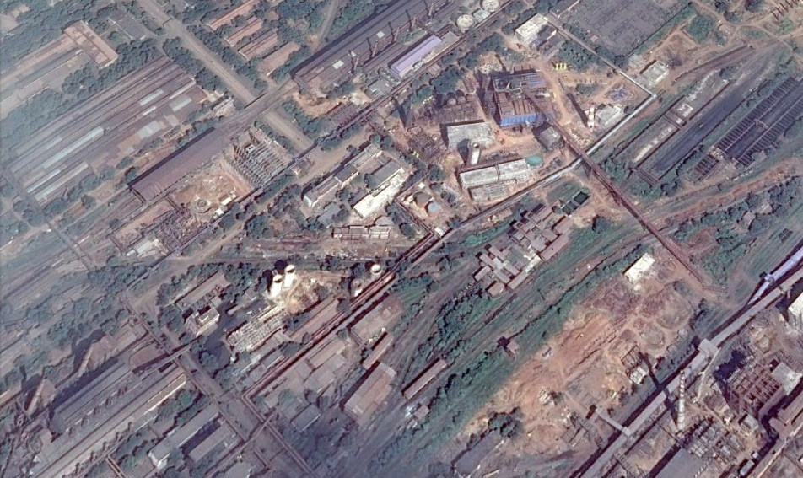
Site Map
N
3 STB
RCL
2 Boiler
DM water Plant
25MW STG
Pump House
Cooling Tower
1 Boiler
4 MW BPTG

Slide 7
Project Packages of PBS –II Modex unit
Package | 011-01-A | 011-01-B | 011-01-C | 12
Installation | 3 Boilers and its auxiliaries. STB Building along with EOT crane | 25 MW STG, 4 MW BPTG, Cooling Tower, Pump House | 3X 225 M3 /Hr. DM water Plant | 3 STB`s and its auxiliaries.
Contractors Contract signing date | M/s Fujian Longking Corporation Ltd. and M/s Allied Engineering Services Pvt. Ltd. 24.03.12 | M/s Triveni Engineering and Industries Ltd.,Banglore 19.01.12 | M/s TechnoFab Engineering Ltd., New Delhi 25.02.12 | Bharat Heavy Electricals Ltd. 11.11.10

Slide 8
Timeline so far
Project allotted
Met Our Mentor Mr V.s. Dewangan
1st June, 2017
2nd June, 2017
Covered Boiler, STG 25 MW, cooling tower and pump hose and STB
3rd June 2017 to 17th June 2017
Started going to various sites for exposure and understanding of various machines
3rd June 2017 to 17th June 2017
Notes:
The following slides show several examples of timelines using SmartArt graphics.
Include a timeline for the project, clearly marking milestones, important dates, and highlight where the project is now.

Slide 9
Timeline ahead
BPTG 22nd June
covering STB
24th June
Start the calculations and final project report
26th June
Rechecking and verifying the calculations done
Around 30th June

Slide 10
Boiler
3 Boilers – 2 in New PBS site and 1 in existing PBS.
Natural circulation, single drum, water tube, balanced draft, radiant type.
Capacity 150 TPH of each boiler.
Steam pressure at super heater outlet 40 ata.
Temperature of steam at outlet is 450ºC (+3/-2).
Fuel
Main: BF and BOF gas mixture.
Startup: LDO/CO gas.

Slide 11
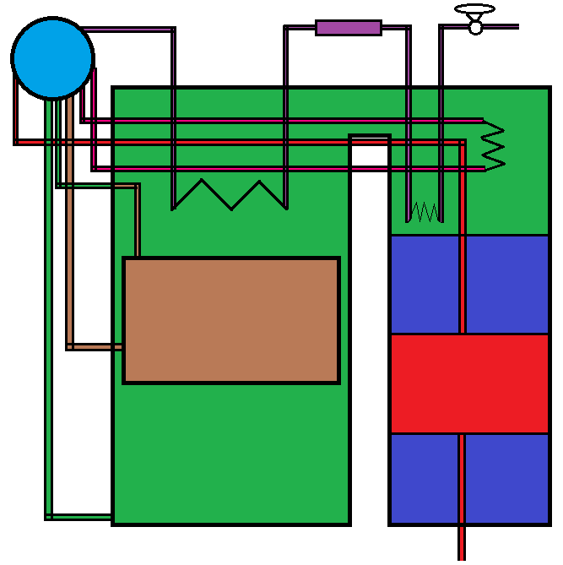
Boiler Drum
De super heater
To steam header
Evaporator
Top header
High temperature super heater
Low temperature super heater
Down comer
Upper air preheater
Center water wall
Economiser
Gas and Oil Burner
Water wall
Lower air preheater
Bottom header
From Boiler feed pump

Slide 12
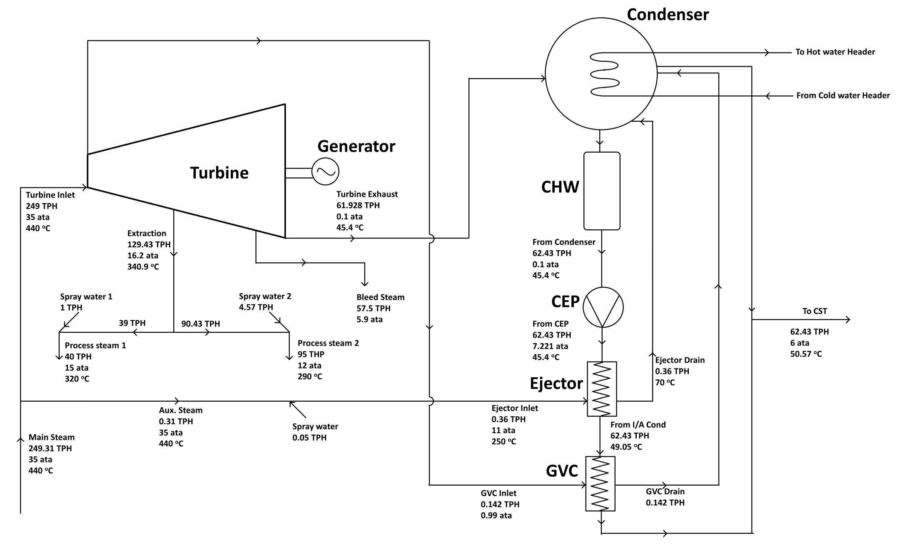
STG 25MW Process Flow

Slide 13
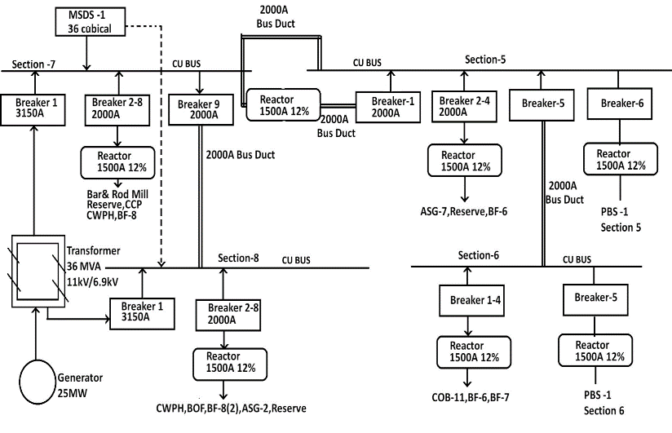
STG 25MW Electrical

Slide 14
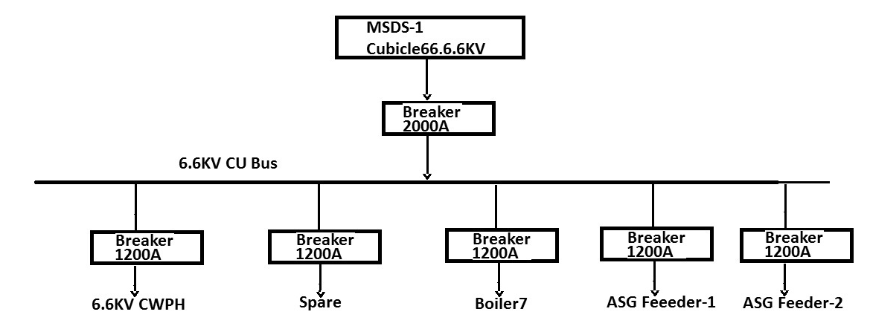
STG – Electrical
Reserve Supply Switch Board

Slide 15
STG Electrical Equipment
Equipment | Specification | Location
Transformer | 36MVA 11kV/6.9kV | 0 meters B-C
Breakers | 1. 3150 Amp 2. 2000 Amp | 11 meters A-B
Reactor | 1500 Amp, 12% | 3 meters A-B
DCS |  | 11 meters
LT Panels |  | 11 meters

Slide 16
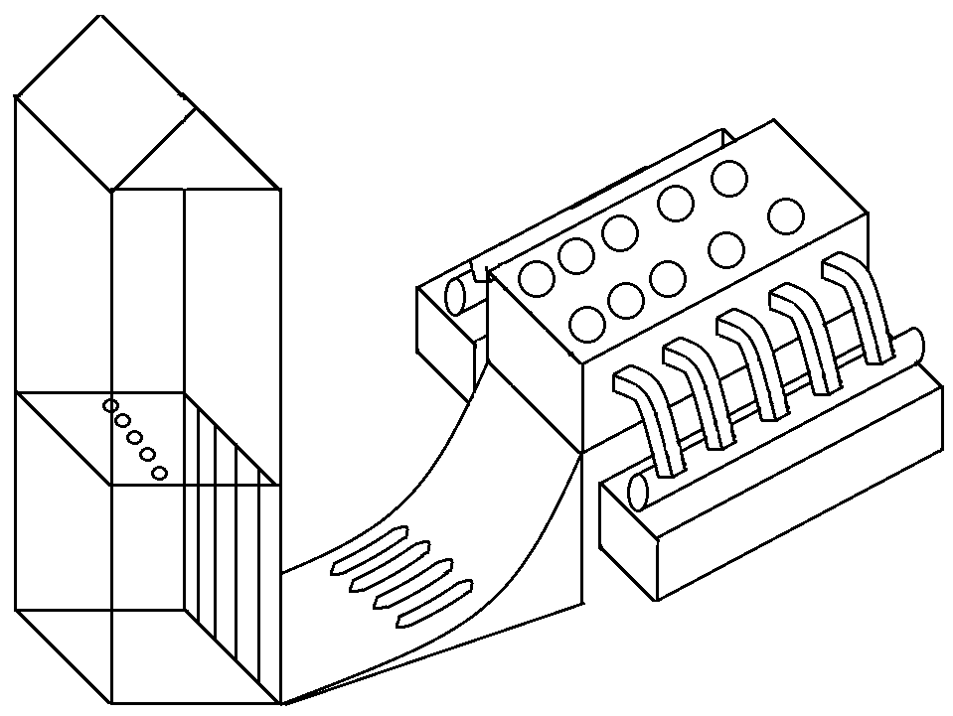
Cooling Tower and Pump House
Pump House
Cooling tower
Cell of Cooling tower
Hot water header from condenser
Vertical Axial water pump
Cold water channel
Sluice gates
Baffles

Slide 17
Cooling Tower and Pump House
10 cooling cells with 9 working and 1 standby.
Temperature reduces from 42ºC to 34ºC at supplied to STG and STB condenser.
Cooling Capacity is 19655 m³/hr.
5 Vertical axial flow pumps with 3 working and 2 standby.
Water sump in pump house has 8.5 m deep.

Slide 18
STB Mechanical Equipment
Equipment | Quantity | Level from Ground
Condenser | 3 | 0 m
Collecting Oil Tank | 3 | 0 m
Transfer Oil Pump | 3 | 0 m
Oil Centrifuge | 3 | 0 m
Transmitted Rack | 3 | 0 m
Lube Oil Tank | 3 | 4.5 m
Pump Skit Assembly | 3 | 4.5 m
Oil Cooler | 3 | 4.5 m
Oil Filter | 3 | 4.5 m
Jacking Oil Pump | 3 | 4.5 m
Control Oil Pump | 3 | 4.5 m
Steam Jet Air Ejector | 3 | 4.5 m
Gland Steam Condenser | 3 | 4.5 m
Governing Oil Console | 3 | 9 m
Main Oil Pump | 3 | 9 m
Common Lube Oil Storage Tank | 1 | 9m
Accumulator | 3 | 9m
TurboBlowers | 3 | 9m
Over Head Tank | 3 | 14.5 m

Slide 19
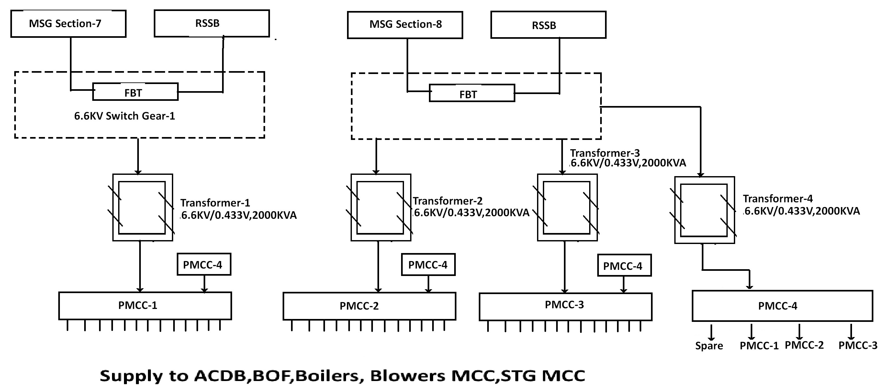
STB- Electrical

